Slide 1

HealthConnect AI
Explainable Disease Prediction Using Machine Learning
Premium, transparent AI for faster clinical decision support — built for clinicians, product teams, and investors.

Slide 2
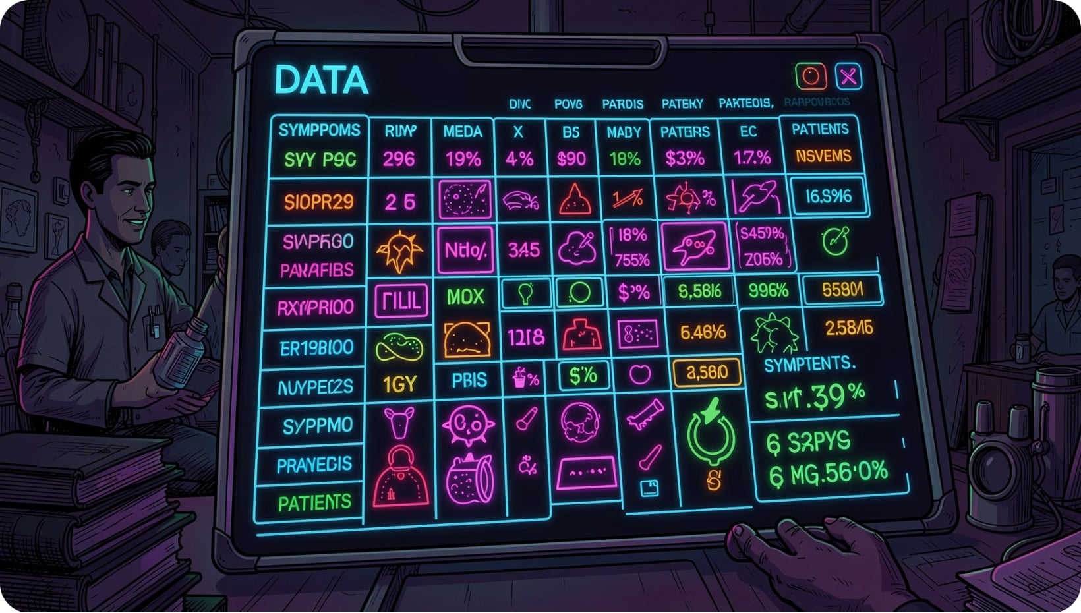
Dataset Snapshot & Core Challenges
Scale
Representation
246,945 patient records · 377 symptom features · 773 disease labels
Binary symptom matrix — sparse, high-dimensional
Class Imbalance
Resource Limits
Many diseases are rare or under‑represented
Training within Google Colab memory and compute constraints
Visual-first summary for technical reviewers and investors — numbers drive design choices.

Slide 3

Machine Learning Pipeline
Raw Dataset
Memory Opt (int8)
Remove Rare Diseases
Label Encoding
Each node includes lightweight memory optimizations and checkpoints to enable reproducible training on constrained compute.

Slide 4


Why Random Forest?
Model
Accuracy
Speed
Memory
Multiclass
Random Forest
High
Moderate
Moderate (quantizable)
Strong
XGBoost
Very High
Slower
Higher
Strong
Decision Tree
Lower
Fast
Low
Limited
Random Forest balances multiclass robustness, interpretability, and quantization-friendly memory footprint — ideal for our sparse, high-class-count dataset.

Slide 5





Not Just Prediction — Explainable Prediction
Fever
High importance — strong signal across respiratory and systemic infections
Symptoms
Feature Importance
Cough
Key driver for pulmonary disease predictions
Random Forest
Prediction & Explanation
Chest Pain
Elevated weight for cardiovascular and pulmonary differentials
We expose the model's reasoning: the top contributing symptoms and their importance scores are presented alongside every prediction.
Fatigue
Broad but informative — increases posterior probability for systemic diseases

Slide 6
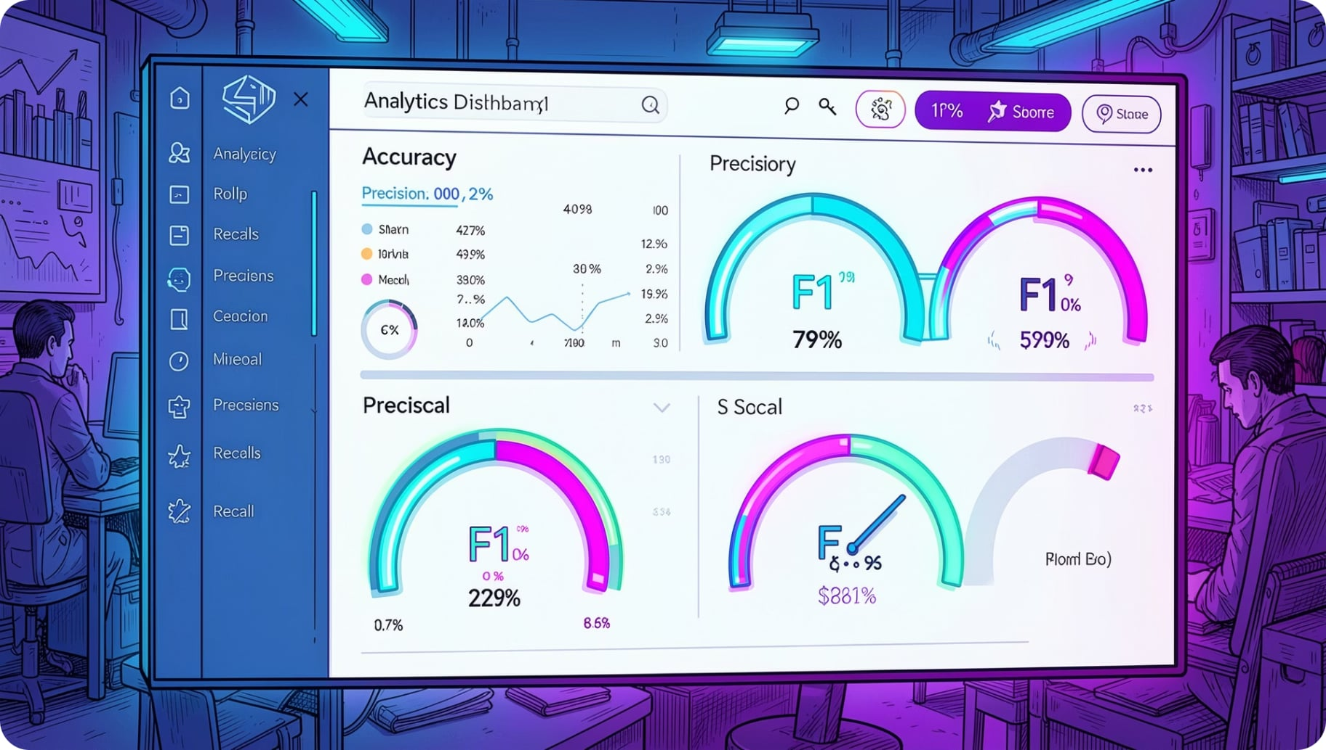
Model Performance — Dashboard
Metrics
Feature Importance
Accuracy: (aggregate visual)
Precision / Recall: per-class panels
F1 Score: harmonic summary
Bar visualization highlights symptom weights — used in explanations and clinician review.
Top Diseases
Limitations
Ranked by performance and prevalence; rare-disease performance flagged for review.
Reduced reliability for very low-sample diseases — flagged and routed to clinician oversight.
Key metrics (example visuals): Accuracy, Precision, Recall, F1 — surfaced for top N diseases and aggregated across classes.

Slide 7
Deployment Architecture
Explore Data
Train Model
Inference API
Results & UI
Cloud-native inference API, lightweight on-device cache for latency-sensitive triage, audit trails for regulatory compliance.

Slide 8


Roadmap & Next Steps
Q3 — Validation
1
Clinical validation with hospital partners and retrospective case review
2
Q4 — Regulatory Prep
Documentation, explainability reports, and safety case development
Q1 — Pilot
3
Live pilot in 2 clinics with clinician feedback loop
4
Q2 — Scale
Optimization for larger deployments, model updates, and SDK release
Investor focus: measurable milestones, regulatory readiness, and clear pilot-to-scale pathway.

Slide 9

Thank You
HealthConnect AI
"Making Disease Prediction Smarter, Faster, and Explainable."
Contact: info@healthconnect.ai · Demo & investor materials available on request

